Slide 1
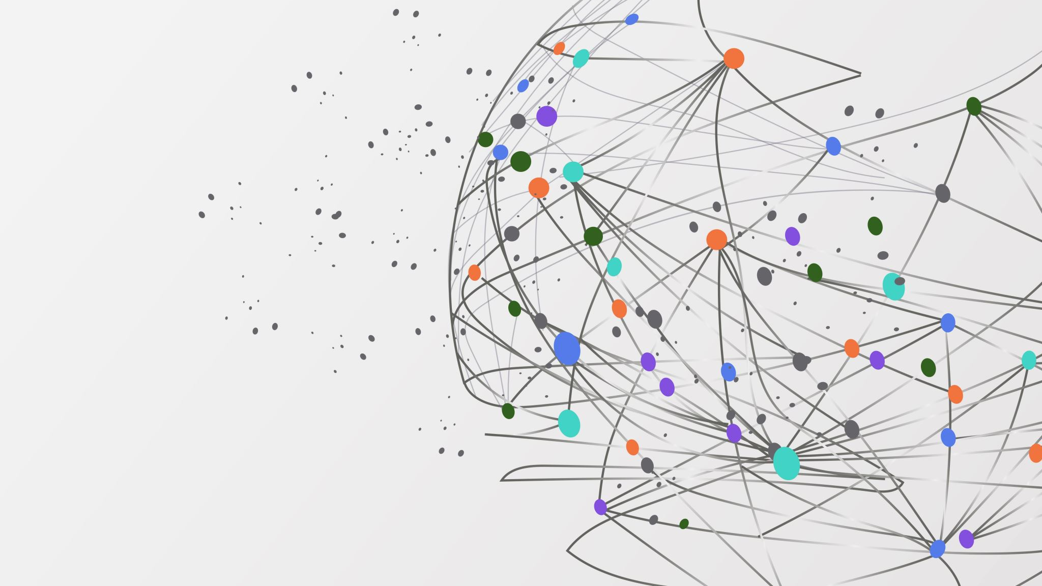
Brain MRI processing for enhancing Alzheimer’s diagnosis
Michela Proietti 1739846
Sofia Santilli 1813509

Slide 2
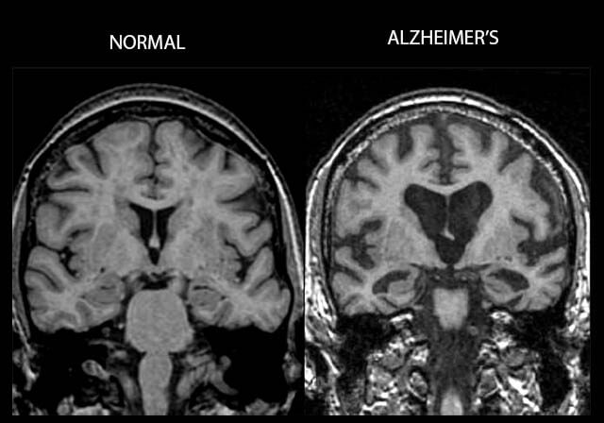
What is Alzheimer Disease (AD)?
AD is a neurodegenerative disease that gradually affects neural cells, causing a progressive dementia
It mainly affects the elderly population, even if initial signs of degeneration can be detected even in younger individuals
The main indicators for the diagnosis of Alzheimer are tissue atrophy, precuneus and hippocampus atrophy

Slide 3
Magnetic resonance imaging (MRI)
Magnetic resonance imaging (MRI)
High spatial resolution
Ability to contrast soft tissue
Non-invasiveness
Less health risks than PET or CT
Automatic analysis of brain MRI allows to have an early diagnosis of Alzheimer
Artifacts
Respiratory and cardiac motion
Inappropriate spatial encoding
Thermal noise
Hardware-induced errors
Body temperature
Other noises
Low SNR in some regions or tissues
Accuracy limit in the current state-of-the-art for segmentation and classification methods
IMAGE DENOISING

Slide 4
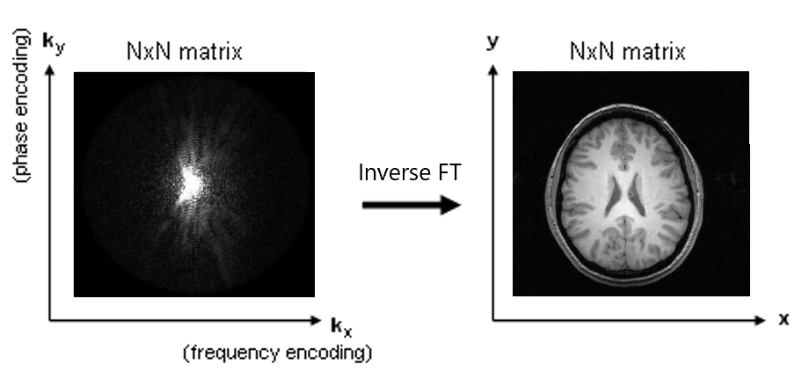
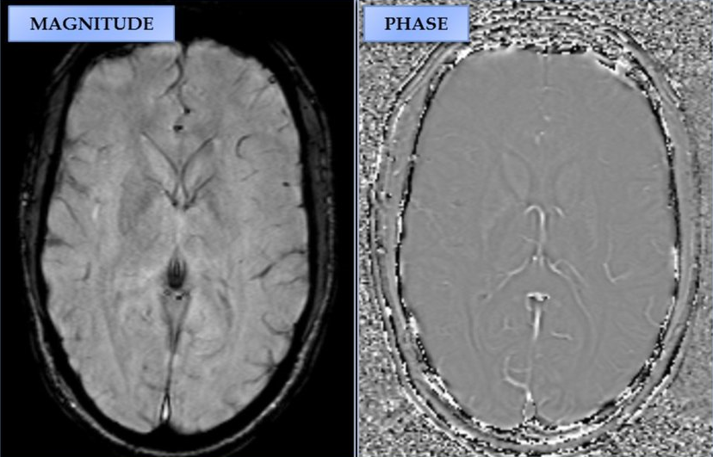
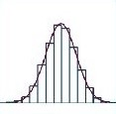
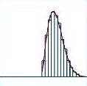
K-space and noise distributions
I x I
Gaussian distribution
Gaussian distribution
Rician distribution

Slide 5
State-of-the-art in MRI Denoising
Filtering, transformations, or statistical methods (bilateral filtering, non-local means and BM3D currently are the most widely-used)
Convolutional NNs: exploited for their small receptive field (SCNN, DnCNN)
Autoencoders: may loose important information (as edge or fine structure)
U-net: large receptive field by utilizing multi-scale features
GANs: U-net often chosen as generator

Slide 6
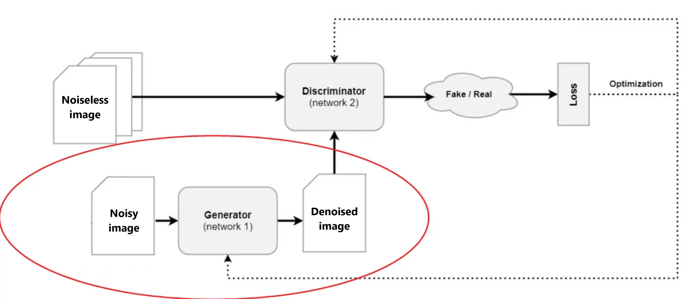
Proposed approach

Slide 7
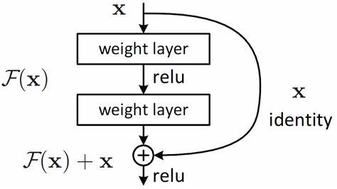
Our Novelty
Generator
Denoising residual network
Skip connections
Batch normalization
No pooling, stride or dilation
Discriminator
Simple CNN
It could be changed depending on the performance of the generator
Figure: Residual block

Slide 8
Validation and comparisons
Apply our denoising algorithm on different dataset for Alzheimer’s classification
Use transfer learning in order to achieve a relatively fast but accurate classification
Compare the classification results obtained using our denoising algorithm to preprocess the images and those obtained without denoising

Slide 9
Expected results
Increase in the classification accuracy by around 10% with respect to the classification done on a noisy dataset
Not excessively long training time

Slide 10
References
Daiki Tamada, “Review: Noise and artifact reduction for MRI using deep learning”. 28 February 2020, Department of Radiology, University of Yamanashi, Chuo, Yamanashi, 409-3898, Japan
M. Tian and K. Song, "Boosting Magnetic Resonance Image Denoising With Generative Adversarial Networks“, in IEEE Access, vol. 9, pp. 62266-62275, 2021, doi: 10.1109/ACCESS.2021.3073944.
Nagaraj Yamanakkanavar, Jae Young Choi and Bumshik Lee, “Review: MRI Segmentation and Classification of Human Brain Using Deep Learning for Diagnosis of Alzheimer’s Disease: A Survey”, 7 June 2020, Department of Information and Communications Engineering, Chosun University, Gwangju 61452, Korea
Haoyu Ren, Mostafa El-Khamy, Jungwon Lee, “DN-ResNet: Efficient Deep Residual Network for Image Denoising”, 16 October 2018
Nikolas Adaloglou, ”Understanding the receptive field of deep convolutional networks”, 2 July 2020
Nikolas Adaloglou, ” Intuitive Explanation of Skip Connections in Deep Learning”, 23 March 2020

Slide 11
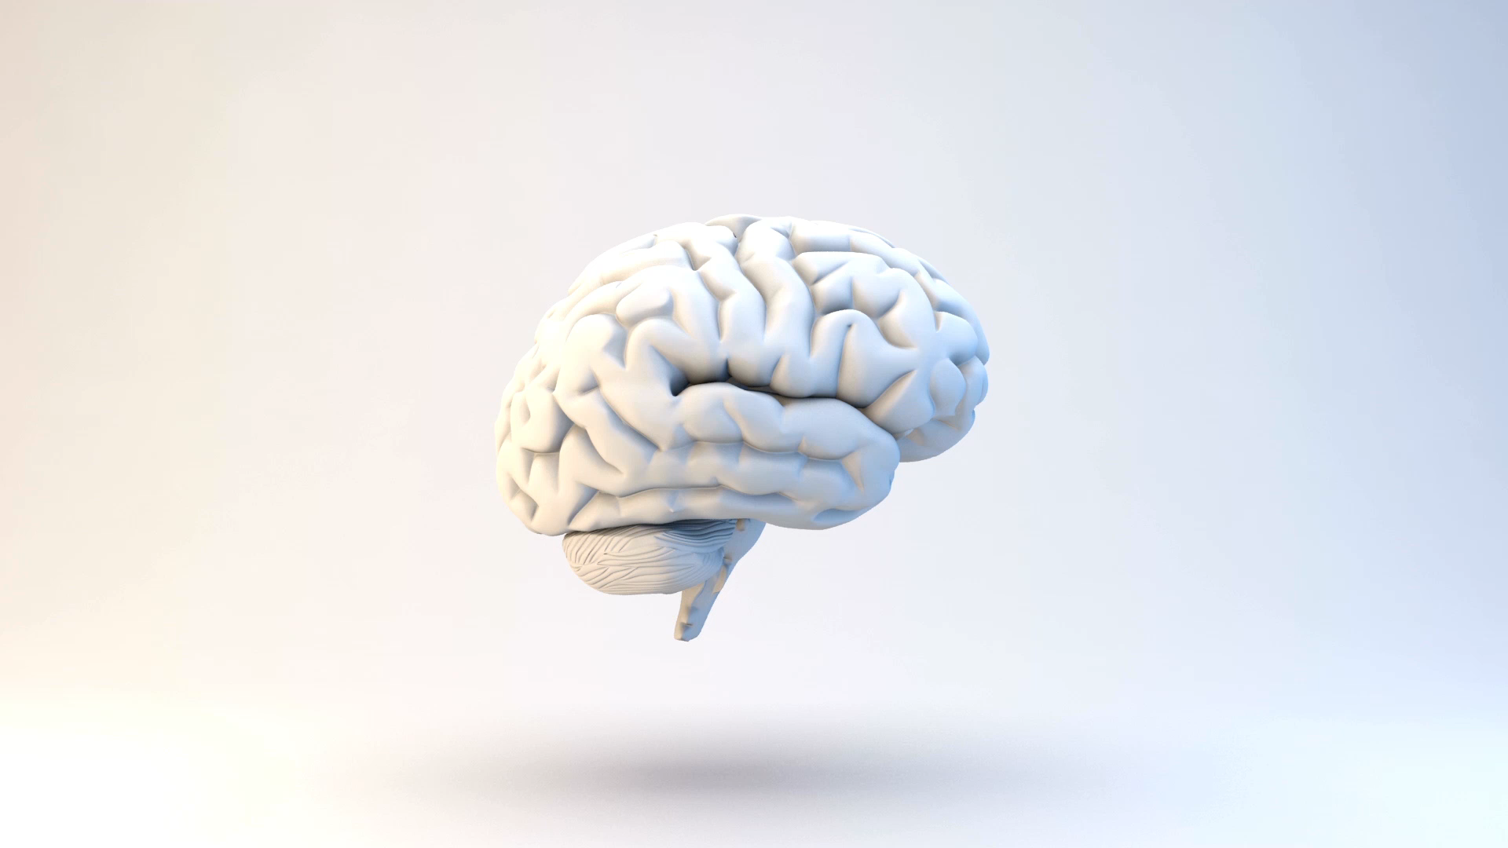
Questions?

